Slide 1
Web Development Fundamentals
Learn CSS

Slide 2
Learning Objectives:
  Explain what CSS is?
  How to use it to style pages?
  Purpose of using CSS
  Writing Style Sheets:
  Style Sheet Strategies:
  Using Id’s
  Using Classes
  font properties
  text properties
  styling links
  styling background
  styling tables
  What is the box model?

Slide 3
What is CSS?
CSS stands for cascading style sheets:
Created by Hakon Lie of MIT in 1994
Has become the W3C standard for controlling visual presentation of web pages
Cascading style-sheets are powerful mechanism to add style to web document
Enforce standards and uniformity
Create dynamic effects
Works by allowing you to specify rules

Slide 4
Purpose of using CSS
Saves time
Easy to change
Pages load faster
Keep consistency
Give you more control over layout
Use styles with JavaScript
Multiple Device Compatibility

Slide 5
Writing Style Sheets in CSS:
Let us understand the differences among inline, internal, and external style sheets.
In-line styles:
Add styles to each tag within the HTML file.
Use it when you need to format just a single section in a web page
Style attribute is used to add style.
Example:
<h1 style=“color:red; font-family: sans-sarif” > IU </h1>
Embedded/internal styles
A style is applied to the entire HTML file.
Use it when you need to modify all instances of particular element (e.g., h1) in a web page.
Example:
<style>
h1 {color:red; font-family:sans-serif}
</style>
External style sheet
An external style sheet is a text file containing the style definition (declaration)
Use it when you need to control the style for an entire website
Open a new blank document in Notepad
Type style declarations
  h1 {color:red; font-family:calibri;}
Do not include <style> tags
Save the document as filename.css
Open a HTML file
Between <head> and </head> add
<link href=URL rel=“relation_type” type=“link_type”>
URL is the file.css
Relation_type=“stylesheet”
Link_type=“text/css”
Save this file and the .css file in the same web server directory.

Slide 6
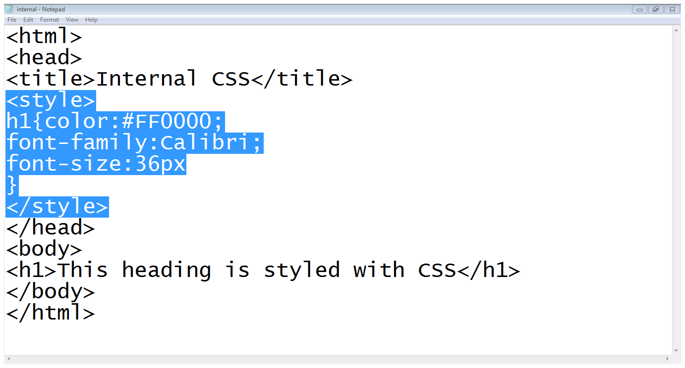
Writing Style Sheets in CSS:
Embedded/internal styles

Slide 7
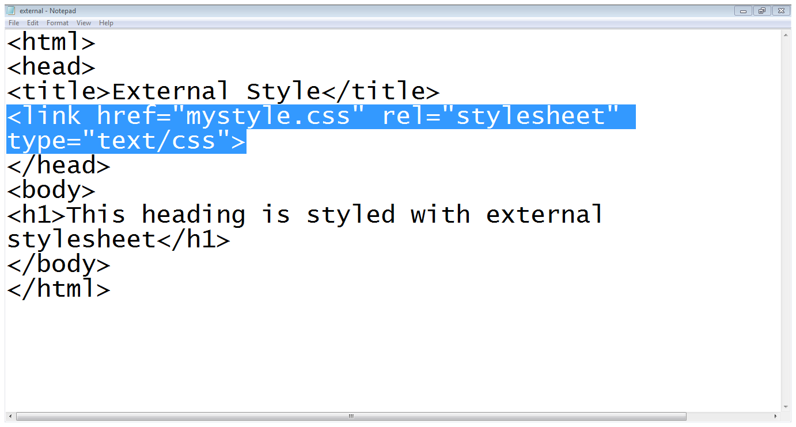
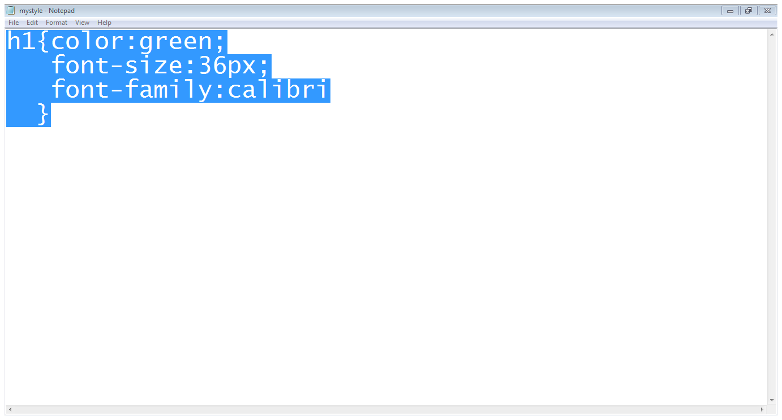
Writing Style Sheets in CSS:
External style sheet

Slide 8
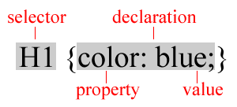
Understand how to declare a style:
A rule consists of
  A selector: element or elements the declaration applies to
  Declaration: how the elements referred to in the selector should be styled
    property: which is the property of the selected element
    value: which is a specification for this property
Using Id’s:
Use an id to distinguish something, like a paragraph, from the others in a document
The id selector is used to specify a style for a single, unique element
Create a style Id:
  #id_name {style attributes and values}
Use a style Id:
  <tag ID=id_name>

Slide 9
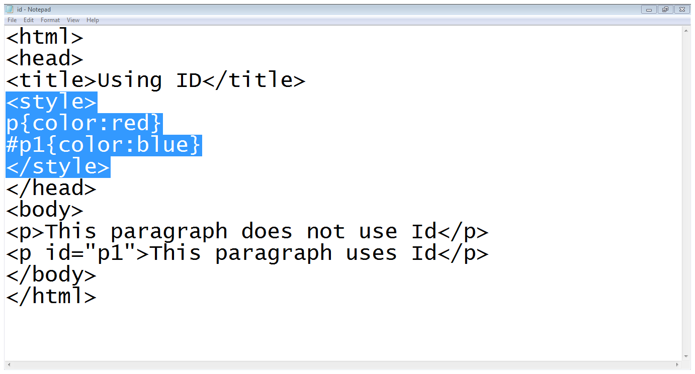
Understand how to declare a style:
Note: HTML requires each id be unique– therefore an id value can only be used once in a document.

Slide 10
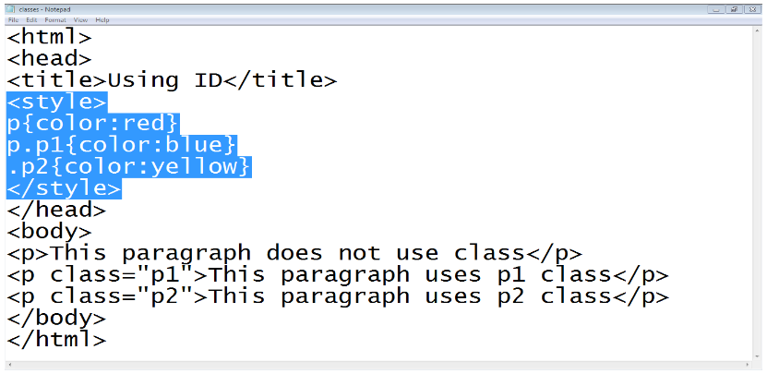
Using Classes:
To create a class
  tag.class_name {style attributes} or
  .class_name {style attributes}
To apply a style
  <tag CLASS=class_name>
    <h1 CLASS=FirstHeader>IU</h1>

Slide 11
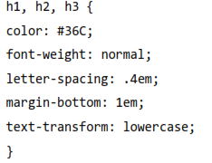
Difference between classes and Id’s:
You can’t have more than one tag with the same ID value
You can apply the same Class value to multiple document tags
  Classes or Id?
      use ID's for any elements that are simply used once on a page
OR
      only use classes to style websites, but, when you have to use an element in JavaScript, use an identifier
  You can apply a style to many selectors if you like

Slide 12
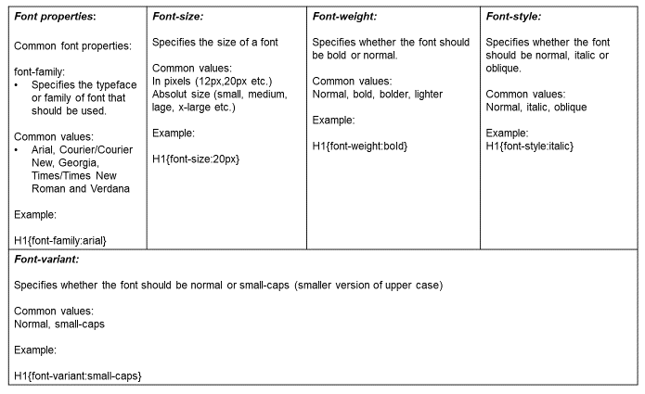
CSS properties:
Font properties:

Slide 13
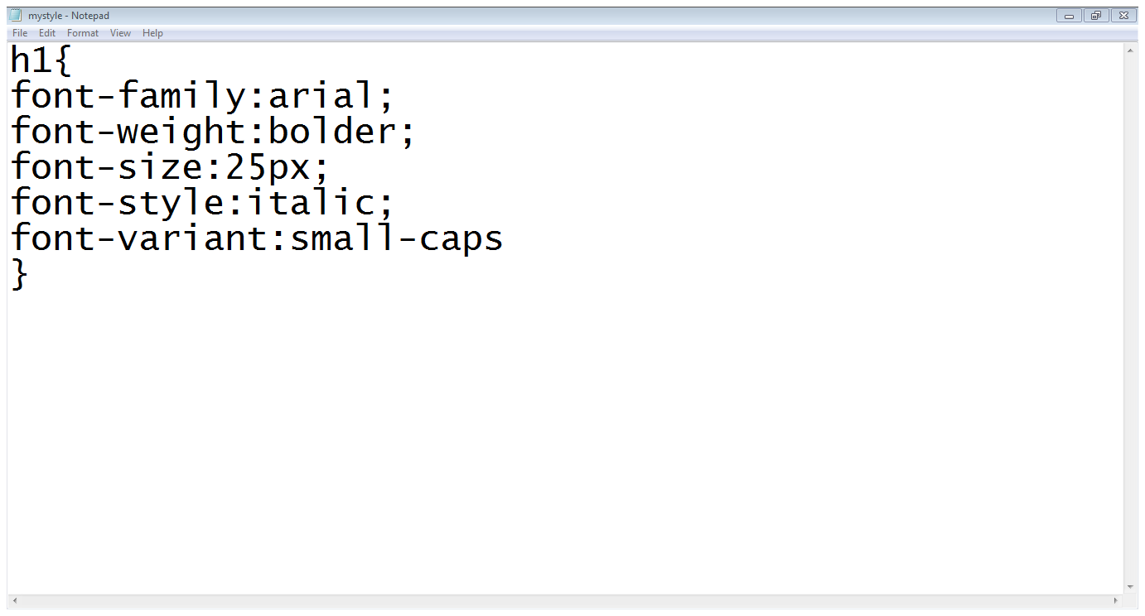
CSS properties:
Font properties:

Slide 14
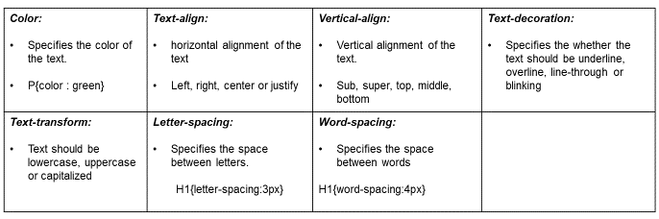
CSS properties:
TEXT properties:

Slide 15
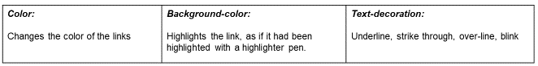
CSS properties:
Styling links:

Slide 16
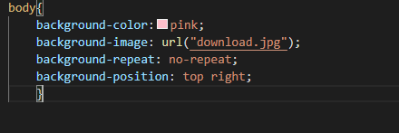
CSS properties:
Styling Background:
background-color:
  Specifies the background color
background-image:
  Specifies the background image
background-repeat:
  Specifies whether the image should repeat or not
background-position:
  Where an image should be positioned.

Slide 17
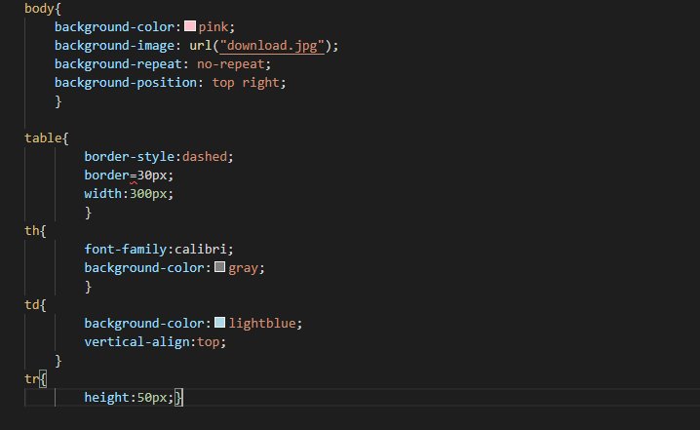
CSS properties:
Styling tables:
text and font
vertical – align
width
height
background - color
background – image
border:
  border-style (solid, dashed, doted, double etc.)
  border-color
  border-bottom (solid, dashed, doted, double etc.)
padding
  Padding-left
  Padding-right
  Padding-top
  padding-bottom

Slide 18
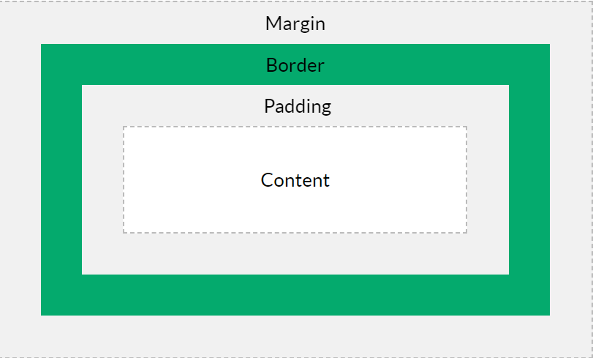
CSS properties:
What is the box model?
Every element on a page is a rectangular box and may have width, height, padding, borders, and margins.
The box model allows us to add a border around elements, and to define space between elements.
Content - The content of the box, where text and images appear
Padding - Clears an area around the content. The padding is transparent
Border - A border that goes around the padding and content
Margin - Clears an area outside the border. The margin is transparent

Slide 19
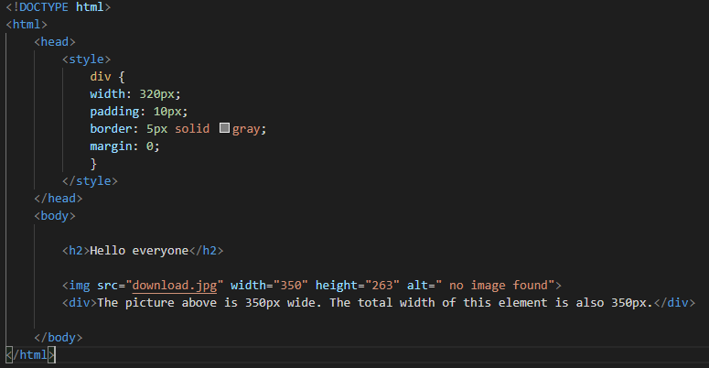
CSS properties:
What is the box model?
Every element on a page is a rectangular box and may have width, height, padding, borders, and margins.
The box model allows us to add a border around elements, and to define space between elements.
Content - The content of the box, where text and images appear
Padding - Clears an area around the content. The padding is transparent
Border - A border that goes around the padding and content
Margin - Clears an area outside the border. The margin is transparent

Slide 20
Questions ?

